Slide 1
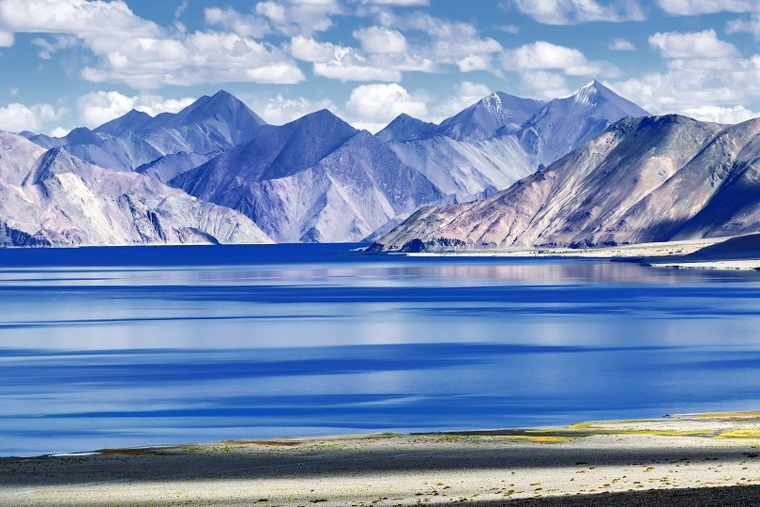
The Cold Desert : Ladakh
GEOGRAPHY PROJECT CLASS 7B
By Sarthak Sidhant

Slide 2
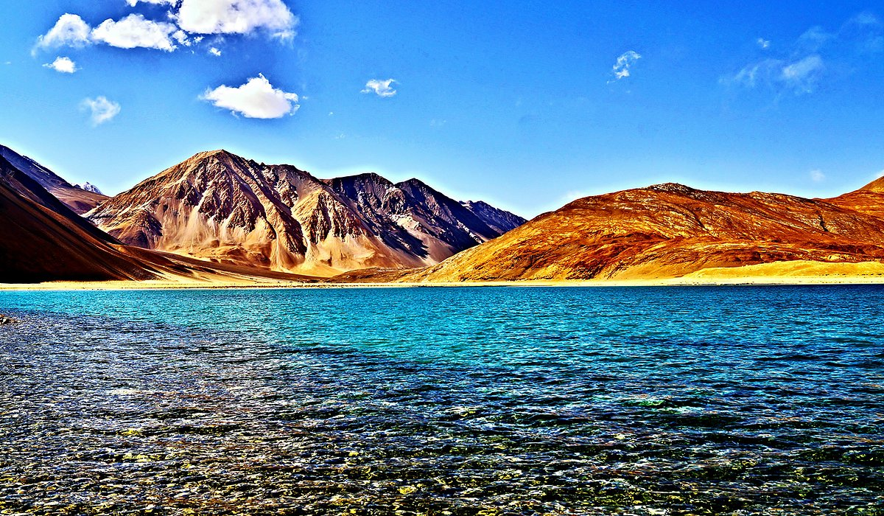
Overview and Climate
By Sarthak Sidhant

Slide 3
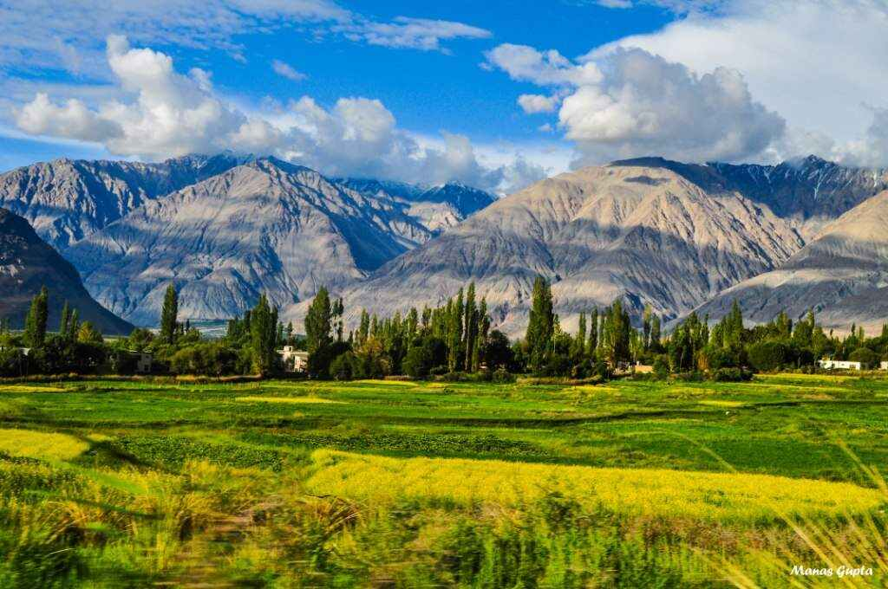
About Ladakh: An Overview
Ladakh is a cold desert in India. It lies in the Great Himalayas, on the eastern side of Jammu and Kashmir. It has the mighty Karakoram Range in the North and in the south, it is bound by the Zanskar mountains. Several rivers flow through Ladakh. The most important one is the Indus.
Due to its high altitude, Ladakh is always freezing cold and dry for most of the year. The air is so thin that you can feel the sun’s heat intensely. In summers, the temperature during the day is just above zero degrees and the night temperature is much below -30°C. In winters the temperature remains as low as -40°C most of the time.
These rivers form deep valleys and gorges. They add to the scenic beauty of the place. Several glaciers are found in Ladakh. The Gangotri glacier is an example. The altitude in Ladakh varies from about 3000m in Kargil to more than 8000 m in the Karakoram.

Slide 4
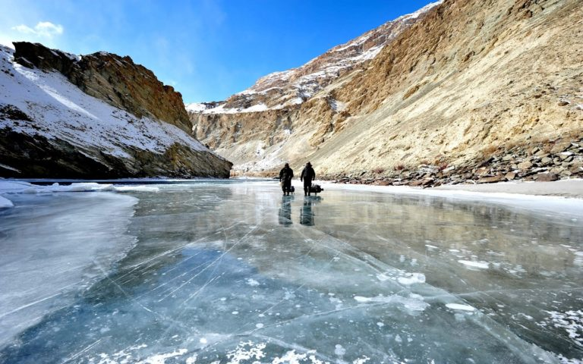
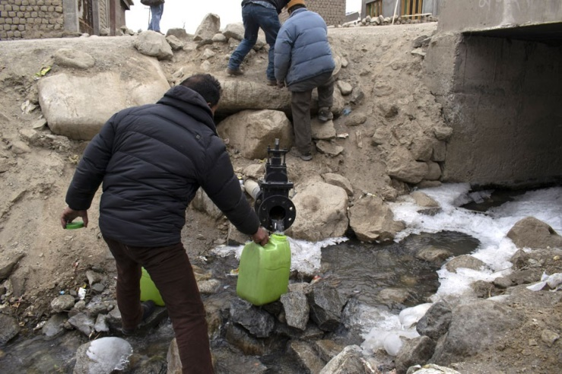
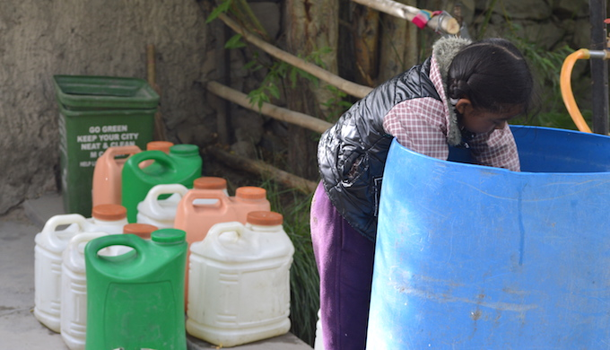
The Climate of Ladakh
The rainfall in this region is as low as 10 cm annually. This is because it lies in the rain shadow of the Himalayas. The area experiences freezing winds and burning sunlight. Therefore, if you sit in the sun with your hand in the shade; you will experience sunstroke as well as frostbite at the same time. Because of Low Rain, Ladakh Experiences Acute Water Shortage, sometimes Fight and mishap take place due to such water scarcity. But Sometimes the things are in control because of Low population in Ladakh.
People Of Ladakh Starving For Water

Slide 5
Flora and Fauna
By Sarthak Sidhant

Slide 6
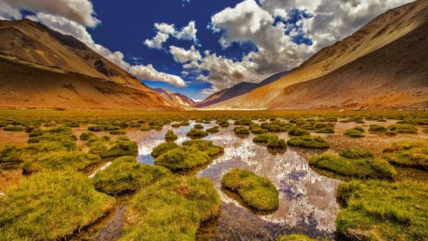
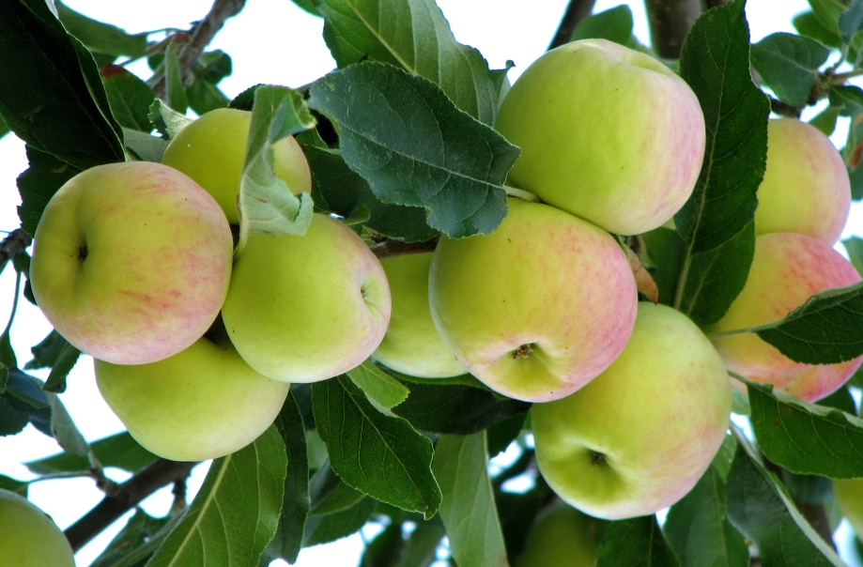
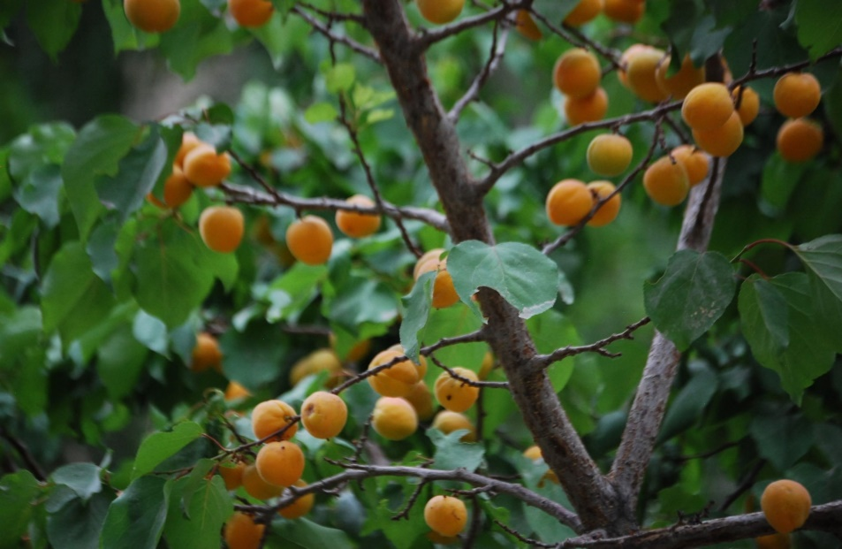
Flora Of Ladakh
Because of the extreme dryness, you would find sparse vegetation in the area. There are scanty patches of grasses and shrubs for animals to graze. During the summers, trees of fruits such as apples, apricots, and walnuts bloom.

Slide 7
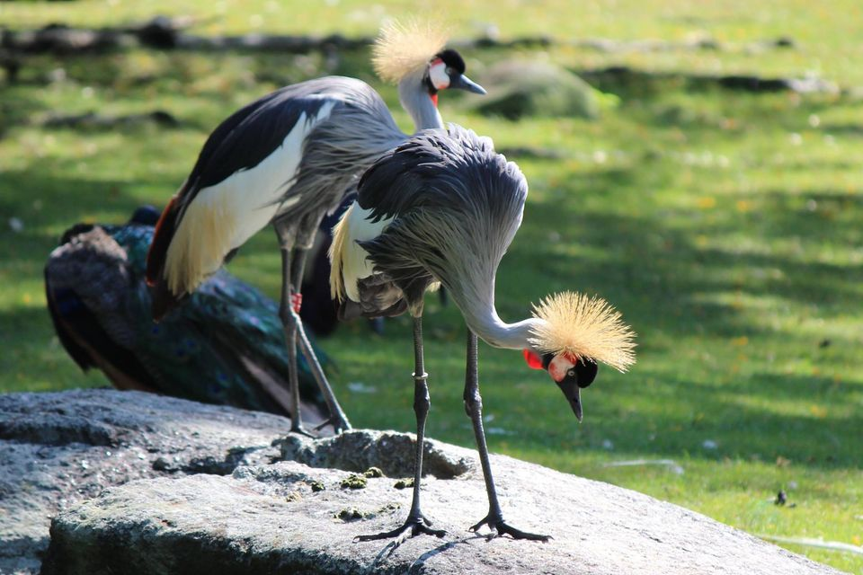
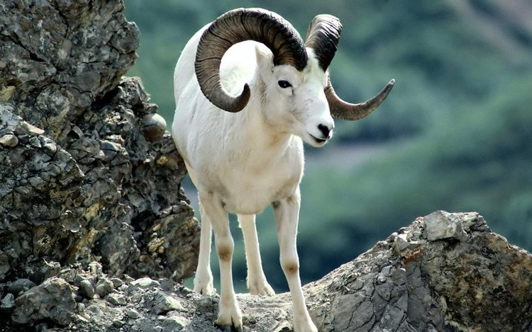
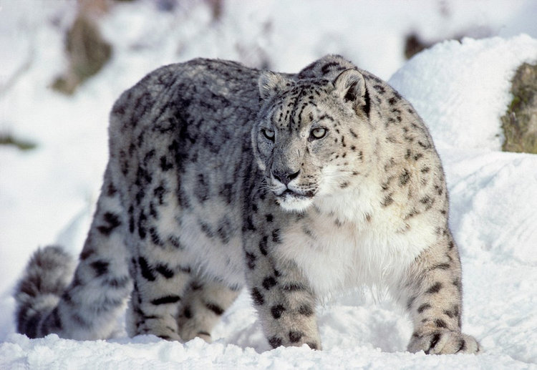
Fauna Of Ladakh
Several species of birds such as robins, redstars, Tibetan snowcock, raven, and hoopoe are common. Some of these are migratory birds. The animals include wild goats, wild sheep, yak and special kinds of dogs.

Slide 8
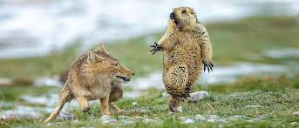
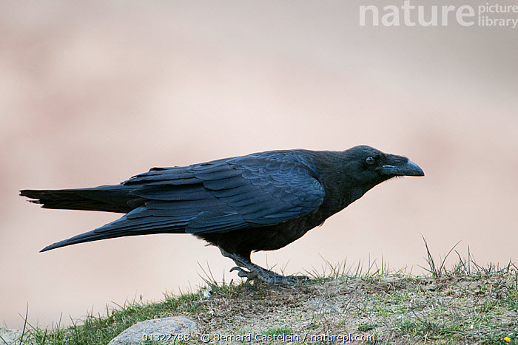
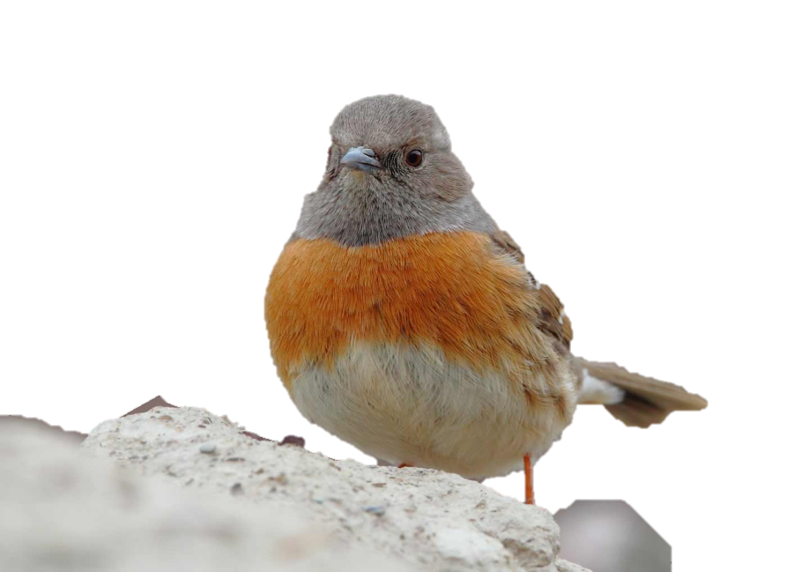
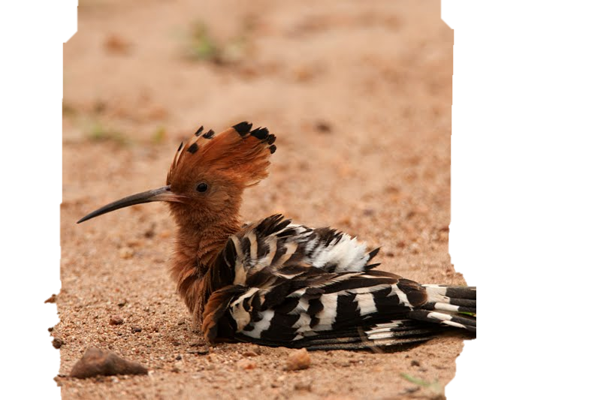
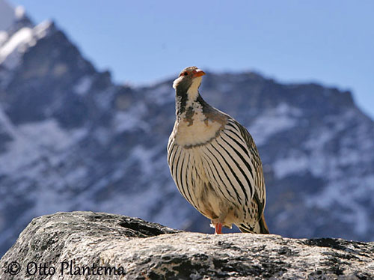
Birds Of Ladakh
The animals are reared to provide:
Milk: Yak’s milk is used to make cheese and butter.
Meat
Hide
Hair: The hair on the sheep and goats is used to make woollens.

Slide 9
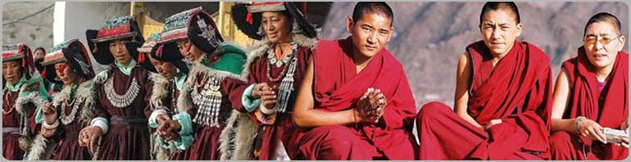
People Of Ladakh
By Sarthak Sidhant

Slide 10
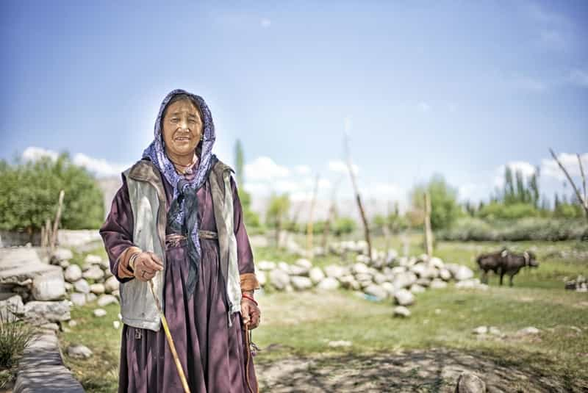
Lifestyle Of People in Ladakh
You would mostly find either Muslims or Buddhists here. Ladakh is blessed with many Buddhist monasteries. Some of the famous monasteries are Hemis, Thiksey, Shey, and Lamayuru. The people of this region resemble the people of Tibet and Central Asia.
Cultivation Activity
    In the summer people usually cultivate barley, potato, beans, p, as and turnip. In the winter months, due to the harsh climate, people keep themselves engaged in festivities and ceremonies. You would find the women working comparatively more than the men.

Slide 11
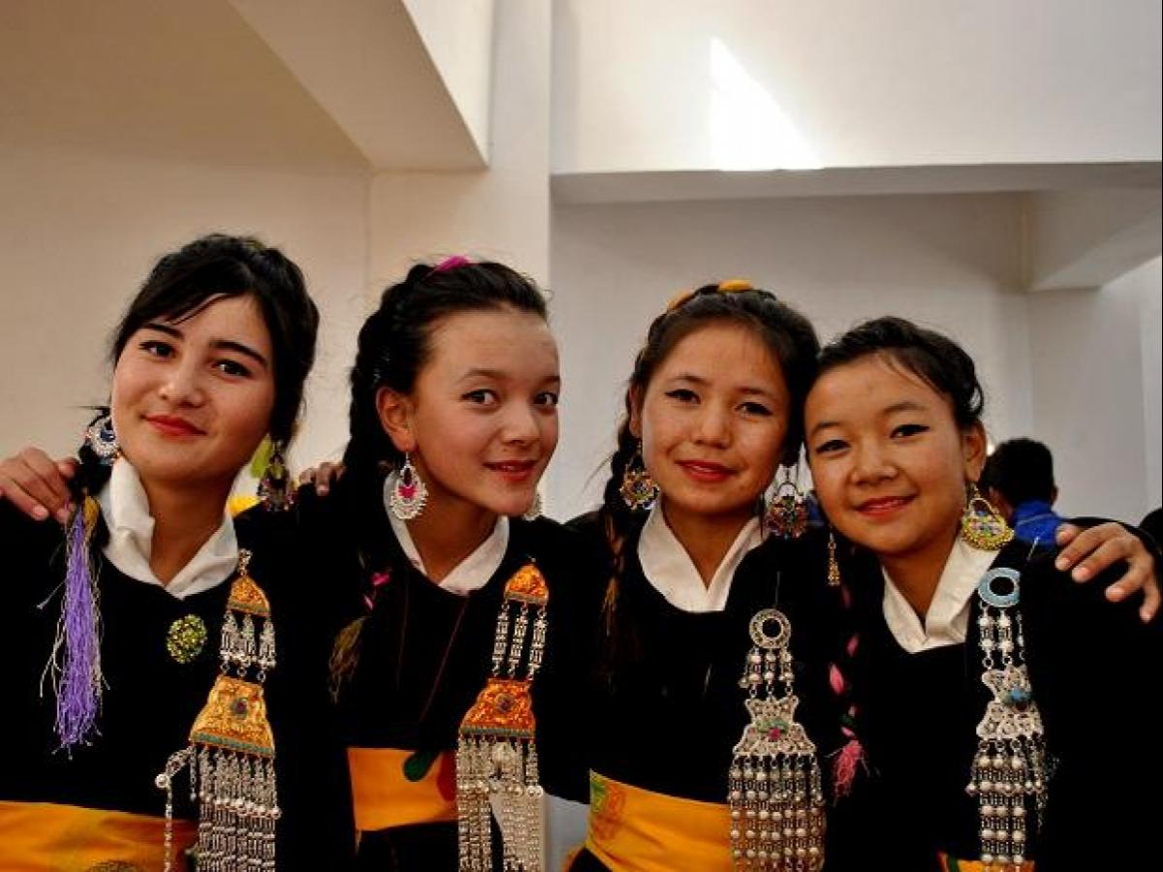
Lifestyle Of People in Ladakh - 2
Business Culture
Since Ladakh is one of the most sought-after tourist places in India, and also the world, the business is quite profound. You will find a lot of small businesses and shops. They cater to the needs of the tourists who visit each year. Mostly, women manage these shops and businesses.
Infrastructure
Leh, the capital of Ladakh is well connected by road as well as air. The National Highway 1A connects Leh to Kashmir Valley through the Zoji La Pass.
Tourism
This is a major tourist attraction for tourists across the globe. The tourists visit the gompas, do trekking to see the meadows and glaciers and witness the ceremonies and festivities. It is a great place for the bikers and the adventure lovers.

Slide 12
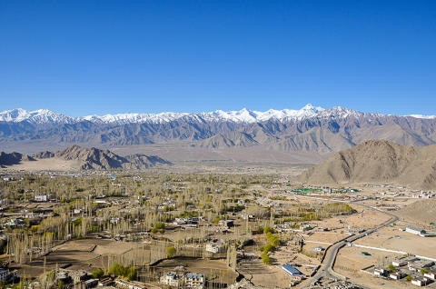
Modernisation in Ladakh
Modernization has not left Ladakh aloof. The life of the people is undergoing a change. This is mainly because of the modern technology and lifestyle. The people of Ladakh have over centuries learned to live in harmony with nature.
Due to the scarcity of resources, they understand their value and conserve them. They do not waste the resources and use them very judiciously. To know the beauty of Ladakh, one has to visit the place. You can get proper enthusiasm when you visit this amazing place.

Slide 13
AKNOWLEDEMENTS
https://static.toiimg.com/imagenext/toiblogs/photo/blogs/wp-content/uploads/2015/07/Mountains-in-Nubra.jpg, https://www.oyorooms.com/travel-guide/wp-content/uploads/2019/06/10-Things-You-Should-Never-Miss-Out-on-a-Trip-to-Ladakh-Image-5.jpg, https://www.toppr.com/ask/question/long-answer-type-questionsdescribe-the-flora-and-fauna-found-in-the-ladakh-desert/, https://www.toppr.com/guides/geography/life-in-the-deserts/the-cold-desert-ladakh/, https://d1whtlypfis84e.cloudfront.net/guides/wp-content/uploads/2018/02/22080114/The-Cold-desert-Ladakh-768x480.jpg, https://www.downtoearth.org.in/news/water/problem-in-paradise-water-crisis-deepens-in-ladakh-amid-surge-in-tourists-61105, https://www.thethirdpole.net/2018/08/01/%E0%A4%B9%E0%A4%BF%E0%A4%A8%E0%A5%8D%E0%A4%A6%E0%A5%80-tourist-magnet-ladakh-facing-water-scarcity/, https://www.reachladakh.com/news/constituency/in-the-past-we-used-to-drink-directly-from-streams-it-s-unthinkable-now-leh-residents, https://i.pinimg.com/564x/35/e0/69/35e06992f4fea95eaede9bb446bb4ba4.jpg, https://dynamic-media-cdn.tripadvisor.com/media/photo-o/0d/79/45/db/pangong-tso.jpg?w=1200&h=700&s=1, https://www.toppr.com/ask/question/the-chiru-or-the-tibetan-antelope-is-an-endangered-species-found-in-ladakh-it-is/, https://upload.wikimedia.org/wikipedia/commons/c/c2/Apple_farming_in_Ladakh_Jammu_Kashmir_India.jpg , https://travelswithsheila.com/wp-content/uploads/2011/09/Day-2-apricots.jpg , https://www.facebook.com/271130742897158/photos/pcb.1185673634776193/1185671018109788/?type=3&theater, https://www.leh-ladakh-taxi-booking.com/img/practical-info/1000x430_tibetan-fox-marmot-himalayan-mountains.jpg, https://images.squarespace-cdn.com/content/v1/5c6afff4af4683a2559c5596/1552601555495-T94WY08FNS0A8VD0LMGM/ke17ZwdGBToddI8pDm48kIIB6g8eAjVUZO-azrWbOQYUqsxRUqqbr1mOJYKfIPR7LoDQ9mXPOjoJoqy81S2I8N_N4V1vUb5AoIIIbLZhVYxCRW4BPu10St3TBAUQYVKcXIGCwurDmULFP4nxlt0Sld7xFjq3UyfSZjh_gMfnu94ZDKCYy_T7OYhOyKv8zDfN/img81.jpg?format=750w, https://images.squarespace-cdn.com/content/v1/5c6afff4af4683a2559c5596/1552601507662-VJ19VLM6QA50UTP3HHZI/ke17ZwdGBToddI8pDm48kCIxSipHSCZDl9I6fzrIWR5Zw-zPPgdn4jUwVcJE1ZvWQUxwkmyExglNqGp0IvTJZamWLI2zvYWH8K3-s_4yszcp2ryTI0HqTOaaUohrI8PIh6JN5dyn8fOwK0vaf5N2oJMBA5hJSn5mBzEIItZ9rmgKMshLAGzx4R3EDFOm1kBS/leopardsnow.jpg?format=750w, https://www.leh-ladakh-taxi-booking.com/practical-info/wildlife-ladakh-mammals-birds-himalayan-animals, https://www.stokpalaceheritage.com/wildlife-of-ladakh, https://www.tripadvisor.com/Tourism-g297624-Ladakh_Jammu_and_Kashmir-Vacations.html, https://www.wildabouttravel.co.uk/w0rdpr3s5/wp-content/uploads/Robin-Accentor-N-Robinson.jpg, http://www.oiseaux-birds.com/galliformes/phasianides/tetraogalle-tibet/tetraogalle-tibet-op3.jpg, https://www.lehladakhtourism.com/about-ladakh/images/ladakh-people.jpg, https://static-blog.treebo.com/blog/wp-content/uploads/2018/05/Webp.net-compress-image-22.jpg, https://journals.openedition.org/samaj/docannexe/image/4208/img-1-small580.jpg, https://bsmedia.business-standard.com/media-handler.php?mediaPath=https://bsmedia.business-standard.com/_media/bs/img/article/2018-10/24/full/1540370952-5014.jpg&width=1200,

Slide 14
Ladakh: A Cold Desert
Prepared By Sarthak Sidhant For Geography Project Class 7/B
Thank You, Well Wishes
Go to Sarthak-Sidhant.github.io For More Information

